Slide 1
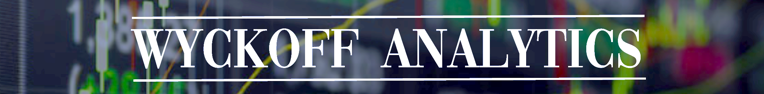
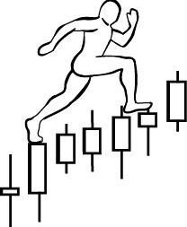
Homework #3:
due on January 28th , 2019
1. Exercise #1: Distribution Labeling
Assignment: Label trading ranges with Wyckoff Phases and Events, and CHoCH
2. Watch recording of January 21st session again (optional assignment)
Email your home work to Roman to simplekot@hotmail.com.
www.WyckoffAnalytics.com Copyright © 2018 Wyckoff Associates, LLC. All Rights Reserved.

Slide 2
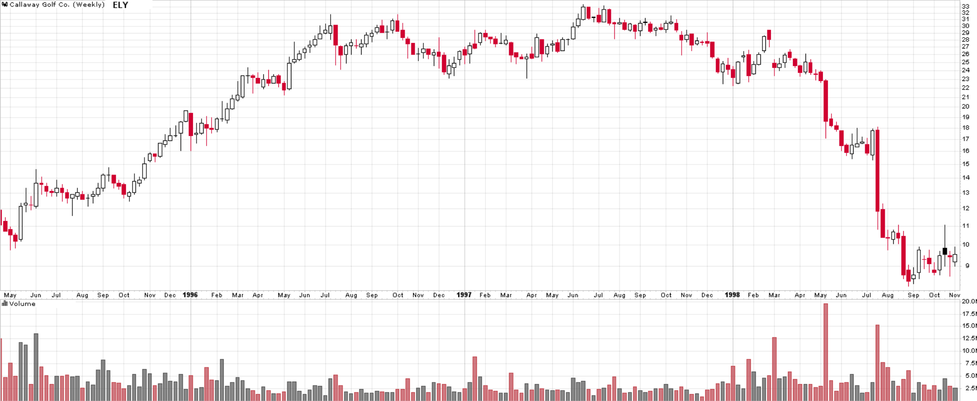
HOMEWORK: Examples of distribution
ELY
www.WyckoffAnalytics.com Copyright © 2018 Wyckoff Associates, LLC. All Rights Reserved.

Slide 3
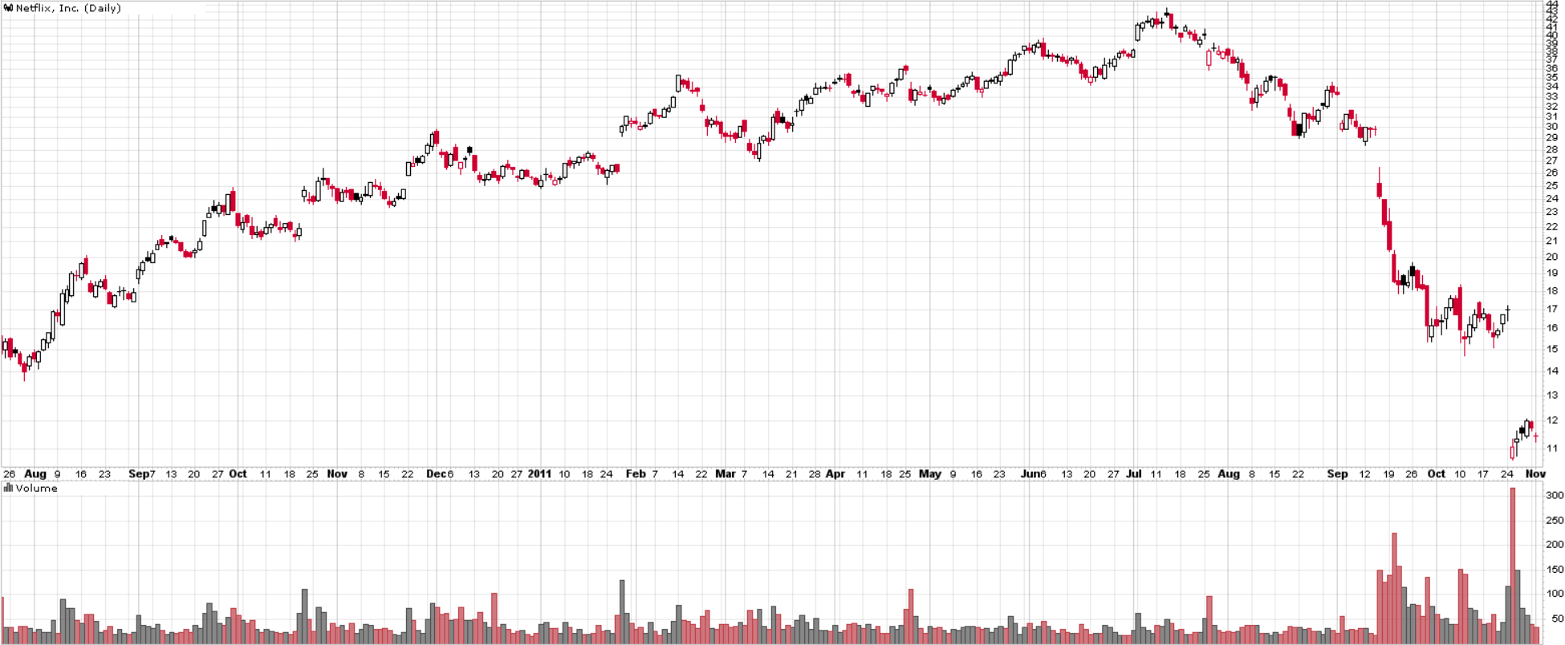
HOMEWORK: Examples of distribution
NFLX
www.WyckoffAnalytics.com Copyright © 2018 Wyckoff Associates, LLC. All Rights Reserved.

Slide 4
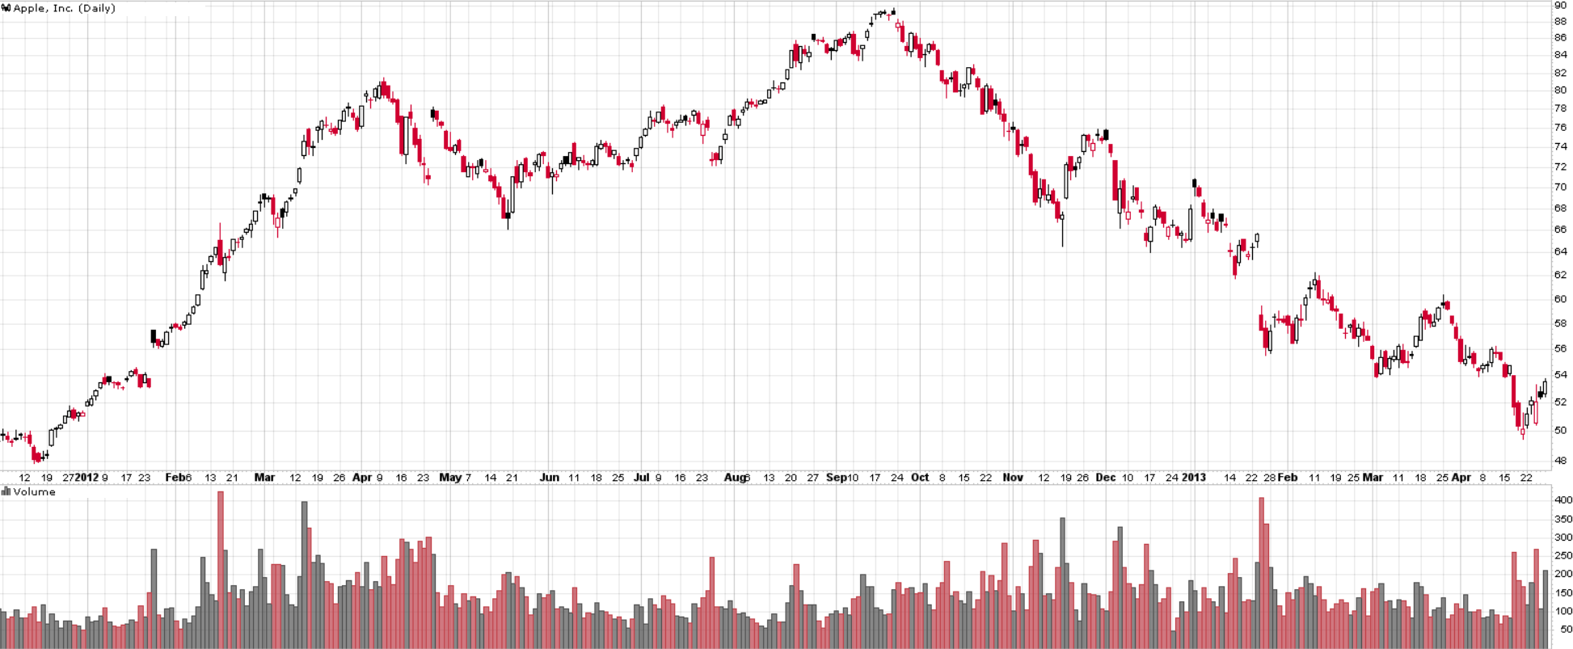
HOMEWORK: Examples of distribution
AAPL
www.WyckoffAnalytics.com Copyright © 2018 Wyckoff Associates, LLC. All Rights Reserved.

Slide 5
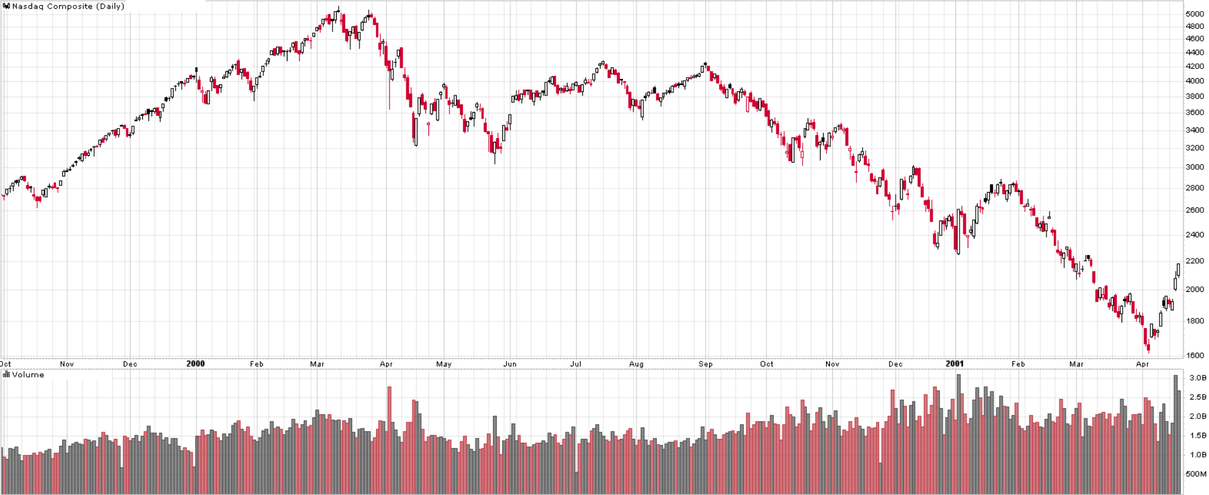
HOMEWORK: Examples of distribution
$COMPX
www.WyckoffAnalytics.com Copyright © 2018 Wyckoff Associates, LLC. All Rights Reserved.

Slide 6
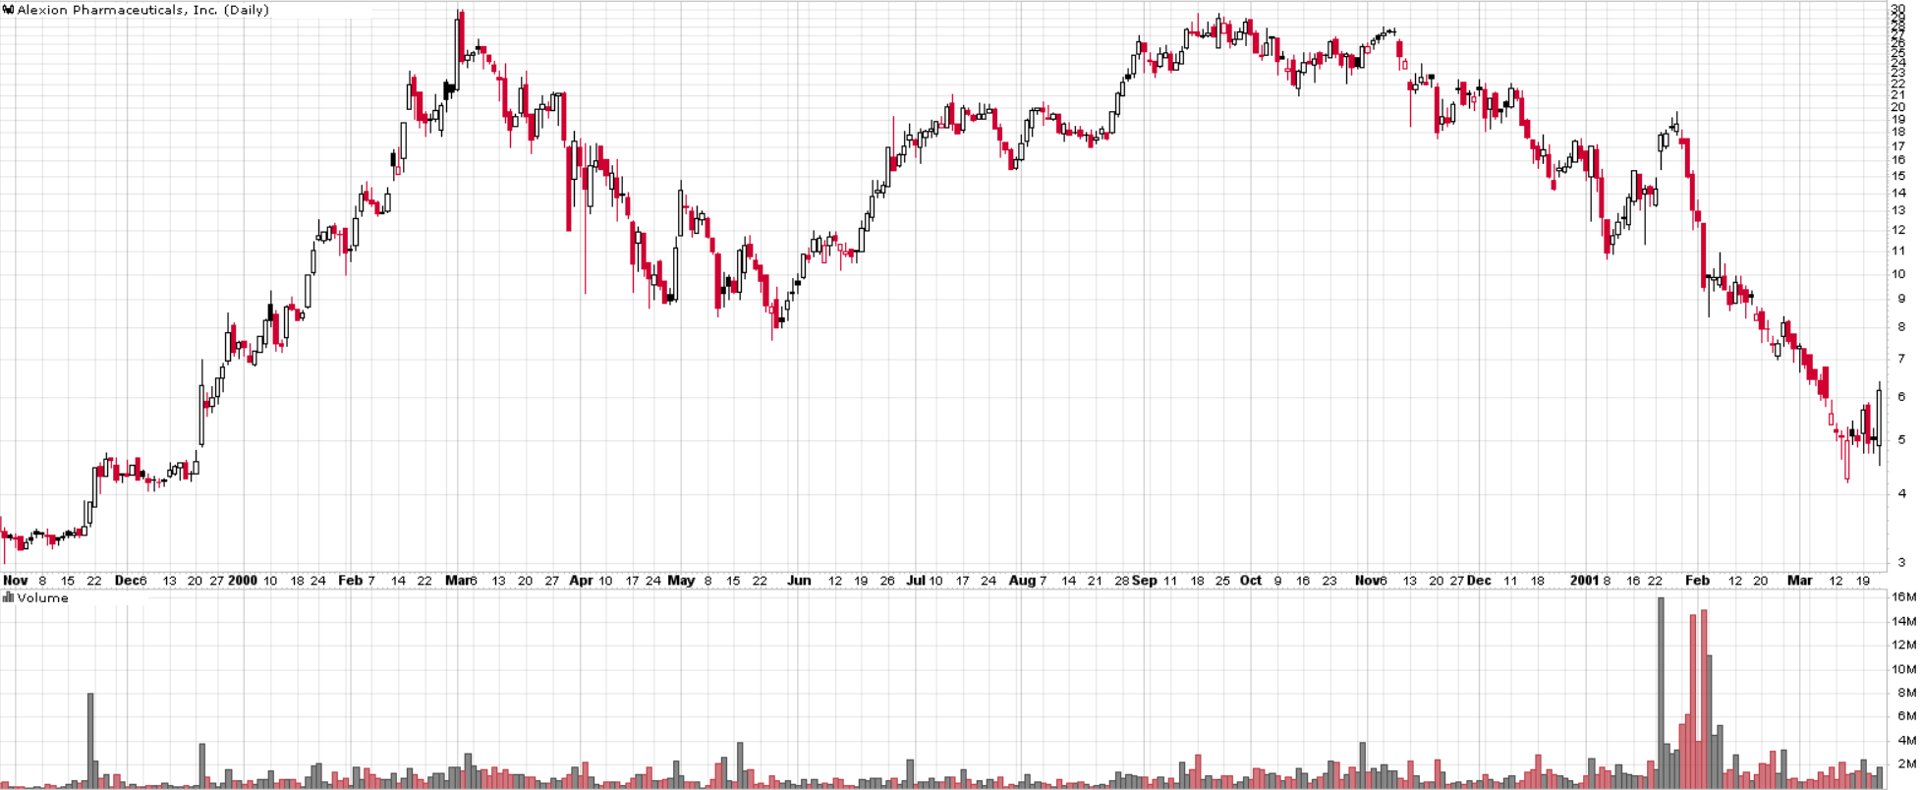
HOMEWORK: Examples of distribution
ALXN
www.WyckoffAnalytics.com Copyright © 2018 Wyckoff Associates, LLC. All Rights Reserved.

Slide 7
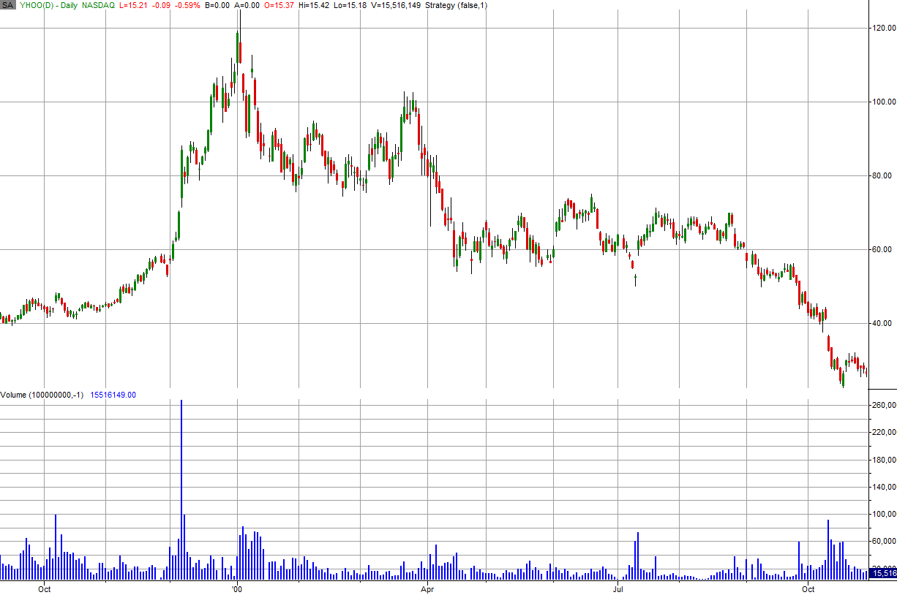
HOMEWORK: Examples of distribution
YHOO
www.WyckoffAnalytics.com Copyright © 2018 Wyckoff Associates, LLC. All Rights Reserved.

